Slide 1

A Scalable and Unified Framework to Weighted Rank Aggregation
Tien-Long Nguyen
Pennsylvania State University, USA
Joint work with:
Amir Carmel (Weizmann Institute of Science, Israel)
Debarati Das (Pennsylvania State University, USA)
ICALP 2026
ICALP 2026

Slide 2






Rank aggregation
Aggregated Rank
$$π_{1}$$
1
2
5
4
3
$$π^{∗}$$
?
?
?
?
?
$$π_{2}$$
5
2
1
4
3
What is the objective?
What is the metric?
$$π_{3}$$
1
3
5
2
4
(k-) median
Kendall-tau
$$π_{4}$$
2
5
1
4
3
(k-) center
Edit
$$π_{5}$$
1
2
3
4
5
…
…

Slide 3
Applications of rank aggregation
Elections
Search engines
Web evaluation systems
Recommendation Systems
ICALP 2026
ICALP 2026

Slide 4





Rank aggregation
Aggregated Rank
$$π_{1}$$
1
2
5
4
3
$$π^{∗}$$
?
?
?
?
?
$$π_{2}$$
5
2
1
4
3
What is the objective?
What is the metric?
$$π_{3}$$
1
3
5
2
4
(k-) median
Kendall-tau
$$π_{4}$$
2
5
1
4
3
(k-) center
Edit
$$π_{5}$$
1
2
3
4
5
…
…

Slide 5







1-Median
Input: a set of point $P= \{x_{1},x_{2},…, x_{m}\}$from a metric space $X$
Output: $med\left(P\right)≝ x^{∗}$ minimizing $d\left(x^{∗}, P\right)≔\sum_{i=1}^{m}{d\left(x^{∗}, x_{i}\right) }$
$$x_{2}$$
$$x_{1}$$
$$x^{∗}$$
$$x_{5}$$
$$x_{3}$$
$$x_{4}$$

Slide 6



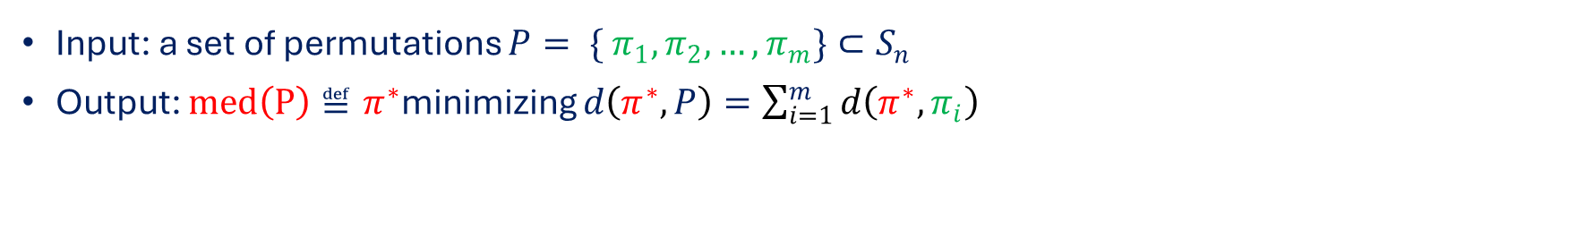



Rank aggregation
Input: a set of permutations $P= \{ π_{1}, π_{2}, …, π_{m}\}⊂S_{n}$
Output: $med\left(P\right)≝π^{∗}$minimizing $d\left(π^{∗}, P\right)=\sum_{i=1}^{m}{d\left(π^{∗}, π_{i}\right)}$
$$π_{2}$$
5
2
1
4
3
$$π_{1}$$
1
2
5
4
3
$$π^{∗}$$
?
?
?
?
?
$$π_{3}$$
1
3
5
2
4
$$π_{4}$$
2
5
1
4
3
Metrics of interest:
Ulam
Kendall-tau
Hamming
Spearman-footrule
$$π_{5}$$
1
2
3
4
5

Slide 7



Real world dataset
600 MILION
100 MILION
4 BILLION
Product rankings
User preference lists
Collaborative playlists
300 MILION
5 BILLION
70 MILION
Active user profiles
Ratings permutations
Tracks to aggregate

Slide 8

Massively Parallel Computation (MPC) model
A theoretical abstraction of tools for handling massive data

Slide 9


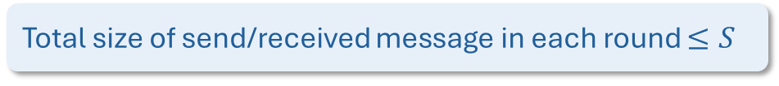

Massively Parallel Computation (MPC) model
All-to-all synchronous-round communication
S
Permutations of size $n$
S
S
Sublinear regime:
Each machine has local memory $S=\tilde{O}\left(n^{1−ε}\right)$
Total size of send/received message in each round $≤S$
S
S

Slide 10


Massively Parallel Computation (MPC) model
$$n^{1−ε}$$
$$n^{1−ε}$$
1
2
5
4
3
1
2
5
4
3

Slide 11
Results (old and new)
2-approximation algorithm for any metric
Output the best permutation
from the input set
Analysis: triangle inequality
Main questions for some metrics
  Beat the 2-approximation

Slide 12
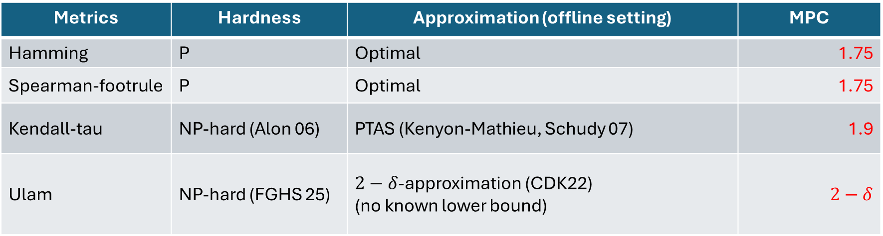
Results (old and new)
New result
Metrics | Hardness | Approximation (offline setting) | MPC
Hamming | P | Optimal | 1.75
Spearman-footrule | P | Optimal | 1.75
Kendall-tau | NP-hard (Alon 06) | PTAS (Kenyon-Mathieu, Schudy 07) | 1.9
Ulam | NP-hard (FGHS 25) | $2−δ$-approximation (CDK22) (no known lower bound) | $$2−δ$$
Via a new unified framework
Remark:
Applies to some weighted version of the above metrics
Improve (weighted) Ulam to 1.968 in offline setting
Notes:
Change 1.9999 to 2-\delta

Slide 13



Our contributions
MPC-friendly Local algorithms (aggregating $Q$)
A new unified framework
Either $∃π_{i}∈P$ close to a median
  Ulam
Kendall-tau
Or $∃ Q⊂P$ : a good approximation of $med\left(Q\right)$ (local solution) is close to a median
Local – global property
Hamming
Spearman-Footrule

Slide 14

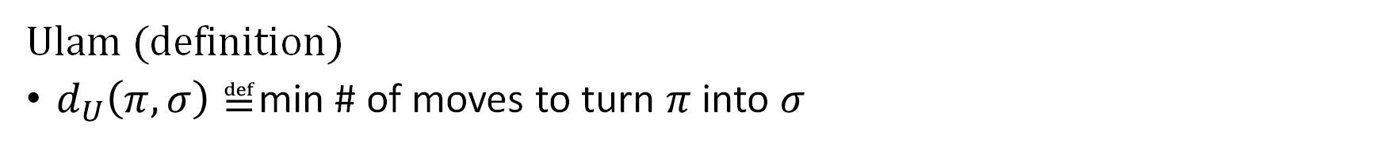
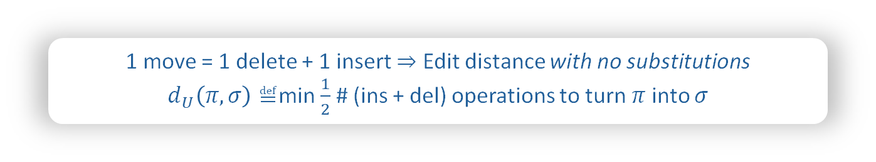


Ulam distance
Ulam (definition)
$d_{U}\left(π, σ\right)≝$min # of moves to turn $π$ into $σ$
$$π$$
1
2
5
4
3
1
2
5
4
3
$$d_{U}\left(12543, 52143\right)=2$$
$$σ$$
5
2
1
4
3
2
1
5
4
3
1 move = 1 delete + 1 insert $⇒$ Edit distance with no substitutions
$d_{U}\left(π, σ\right)≝$min $\frac{1}{2}$ # (ins + del) operations to turn $π$ into $σ$

Slide 15

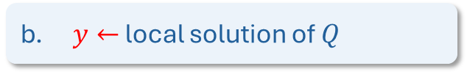
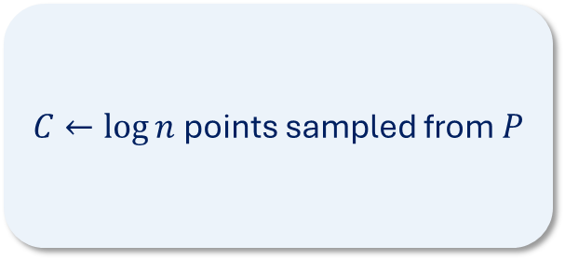
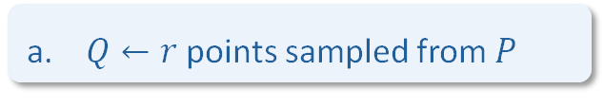
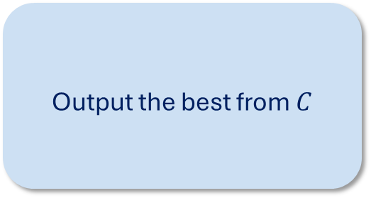
Framework overview
Repeat $\log{n}$ times:
$C←\log{n}$points sampled from $P$
Output the best from $C$
a. $Q←r$ points sampled from $P$
b. $y←$ local solution of $Q$
c. $C←C∪\{y\}$
Notes:
Pop out local algorithm step

Slide 16


Aggregating under Ulam
Input: $Q=\{π_{1},π_{2},π_{3},π_{4},π_{5}\}$
$$π_{1}$$
1
2
5
4
3
$$π_{2}$$
5
2
1
4
3
$$π_{3}$$
2
5
1
4
3
$$π$$
?
?
?
?
?
$$≈med\left(Q\right)$$
$$π_{4}$$
1
3
5
2
4
$$π_{5}$$
1
2
3
4
5

Slide 17


Dynamic Programming Approach
Compute $x={argmin}_{y∈\{1,2,…, n\}^{n}}\sum_{i=1}^{5}{d\left(y,π_{i}\right)}$via dp
Remove repeated symbols
Append the missing symbols arbitrarily at the end
Work in offline setting
Follows the MPC framework for ED requires $≈O\left(n^{5}\right)$space per machine

Slide 18








Cycle Removal Approach (CDK 21)
Build a majority graph
$$π_{1}$$
1 | 2 | 5 | 4 | 3
$$1$$
$$2$$
$$π_{2}$$
5 | 2 | 1 | 4 | 3
$$π_{3}$$
2 | 5 | 1 | 4 | 3
$$π_{4}$$
1 | 3 | 5 | 2 | 4
$$3$$
$$5$$
$$π_{5}$$
1 | 2 | 3 | 4 | 5
$$4$$

Slide 19





Cycle Removal Approach (CDK 21)
Build a majority graph
$$1$$
$$2$$
While $∃$a cycle $C$(a triangle)
Remove C
$$3$$
$$5$$
$$4$$

Slide 20




Cycle Removal Approach (CDK 21)
Build a majority graph
$$1$$
$$2$$
While $∃$a cycle $C$(a triangle)
  Remove $C$
12
Topological sort
Append removed symbols in arbitrary order
12345

Slide 21
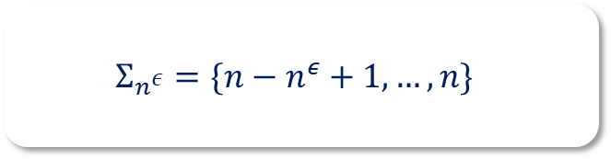

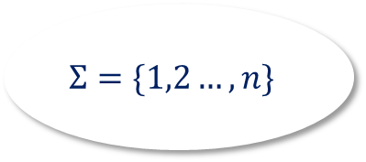
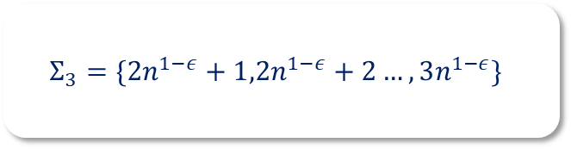

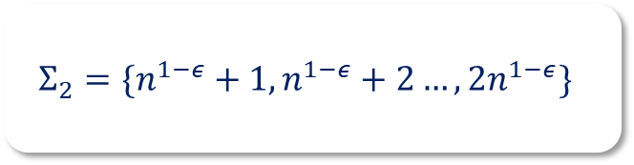



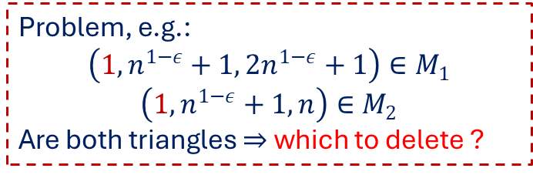


Attempt for MPC Cycle Removal
$$Σ_{1}=\{1,2…, n^{1−ε}\}$$
$$M_{1}$$
$$M_{2}$$
$$Σ_{1},Σ_{2},Σ_{3}$$
$$Σ_{1},Σ_{2},Σ_{n^{ε}}$$
$$Σ_{2}=\{n^{1−ε}+1,n^{1−ε}+2…, 2n^{1−ε}\}$$
…
$$Σ=\{1,2…, n\}$$
$$M_{n^{3ε}}$$
$$Σ_{3}=\{{2n}^{1−ε}+1,2n^{1−ε}+2…, 3n^{1−ε}\}$$
$$Σ_{n^{ε}−2},Σ_{n^{ε}−1},Σ_{n^{ε}}$$
…
Problem, e.g.:
$$\left(1, n^{1−ε}+1, 2n^{1−ε}+1\right)∈M_{1}$$
$$\left(1, n^{1−ε}+1, n\right)∈M_{2}$$
Are both triangles $⇒$ which to delete ?
$$Σ_{n^{ε}}=\{n−n^{ε}+1,…, n\}$$

Slide 22



Succes attempt = DP + Cycle Removal
Ideas:
If $π_{i,j}$ is of medium size (not long/short) $⇒$ possible to “guess” approximately
$$π_{i}$$
$$π_{i,1}$$ | $$π_{i,2}$$ |  | $$π_{i,n^{ε}}$$
Optimal alignment
$$med\left(Q\right)$$
$$B_{1}$$ | $$B_{2}$$ | … | $$B_{n^{ε}}$$
$$n^{1−ε}$$
Notes:
Chek laij phaanf ideas xem co bii nham trang k

Slide 23



Succes attempt = DP + Cycle Removal
Ideas:
If $π_{i,j}$ is of medium size (not long/short) $⇒$ possible to “guess” approximately
$$π_{i}$$
$$π_{i,1}$$ | $$π_{i,2}$$ |  | $$π_{i,n^{ε}}$$
$$med\left(Q\right)$$
$$B_{1}$$ | $$B_{2}$$ | … | $$B_{n^{ε}}$$
$$n^{1−ε}$$

Slide 24
Succes attempt = DP + Cycle Removal
Ideas:
If $π_{i,j}$ is of medium size (not long/short) $⇒$ possible to “guess” approximately
$$π_{i}$$
$$π_{i,1}$$ | $$π_{i,2}$$ |  | $$π_{i,n^{ε}}$$
$$med\left(Q\right)$$
$$B_{1}$$ | $$B_{2}$$ | … | $$B_{n^{ε}}$$
$$n^{1−ε}$$

Slide 25
Succes attempt = DP + Cycle Removal
Ideas:
If $π_{i,j}$ is of medium size (not long/short) $⇒$ possible to “guess” approximately
$$π_{i}$$
$$π_{i,1}$$ | $$π_{i,2}$$ |  | $$π_{i,n^{ε}}$$
$$med\left(Q\right)$$
$$B_{1}$$ | $$B_{2}$$ | … | $$B_{n^{ε}}$$
$$n^{1−ε}$$

Slide 26
Succes attempt = DP + Cycle Removal
Ideas:
If $π_{i,j}$ is of medium size (not long/short) $⇒$ possible to “guess” approximately
$$π_{i}$$
$$π_{i,1}$$ | $$π_{i,2}$$ |  | $$π_{i,n^{ε}}$$
$$med\left(Q\right)$$
$$B_{1}$$ | $$B_{2}$$ | … | $$B_{n^{ε}}$$
$$n^{1−ε}$$

Slide 27

Succes attempt = DP + Cycle Removal
Ideas:
If $π_{i,j}$ is of medium size (not long/short) $⇒$ possible to “guess” approximately
$$π_{i}$$
$$π_{i,1}$$ | $$π_{i,2}$$ |  | $$π_{i,n^{ε}}$$
$${π′}_{i,j}$$
$$med\left(Q\right)$$
$$B_{1}$$ | $$B_{2}$$ | … | $$B_{n^{ε}}$$
$$n^{1−ε}$$

Slide 28










Succes attempt = DP + Cycle Removal
Ideas:
If $π_{i,j}$ is of medium size (not long/short) $⇒$ possible to “guess” approximately
Fix an index block $j$, if at least 4 of $π_{1,j}, π_{2,j},…, π_{5,j}$are of medium size $⇒$ “reconstruct” $B_{j}$ via “cycle removal”
$$B_{j}$$
shares a long LCS
$${B′}_{j}$$
$$π_{1,j}$$
$${π′}_{1,j}$$
$$π_{2,j}$$
guess
$${π′}_{2,j}$$
$$π_{4,j}$$
$${π′}_{4,j}$$
“Cycle Removal”
$$π_{5,j}$$
$${π′}_{5,j}$$

Slide 29

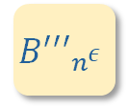








Ideal: this situation happens for all blocks
Ideas:
Combining blocks
  Collect constructed blocks into a single machine
  DP: build a string from these blocks
$$B_{1}$$ | $$B_{2}$$ | … | $$B_{n^{ε}}$$
candidates
$${≥n}^{1−ε}$$
candidates
candidates
$${B′}_{1}$$
$${B′′}_{1}$$
$${B′′′}_{1}$$
$${B′}_{2}$$
$${B′′}_{2}$$
$${B′′′}_{2}$$
$${B′}_{n^{ε}}$$
$${B′′}_{n^{ε}}$$
$${B′′′}_{n^{ε}}$$
…
…
…
Constructed blocks via “cycle removal”
Constructed blocks via “cycle removal”
Constructed blocks via “cycle removal”

Slide 30




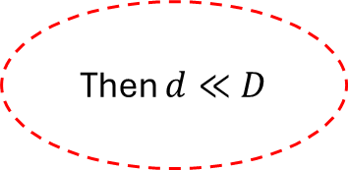
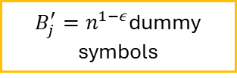
Long blocks, short blocks
Ideas:
If $π_{i,j}$ is long
$$π_{i,j}$$
$$D$$
$$≤D$$
$$B_{j}$$
$$d=n^{1−ε}$$
Then $d≪D$
$B_{j}^{′}=n^{1−ε}$dummy symbols
If for a block $B_{j}$, at least two blocks $π_{i,j}$are short $⇒$can not happen too often

Slide 31

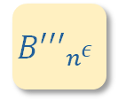




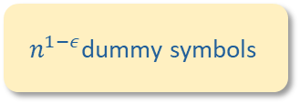
Succes attempt = DP + Cycle Removal
Ideas:
Combining blocks
  Collect constructed blocks into a single machine
  DP: build a string from these blocks
$$n^{1−ε}\text{dummy} \text{symbols}$$
$$n^{1−ε}\text{dummy} \text{symbols}$$
$$n^{1−ε}\text{dummy} \text{symbols}$$
candidates
candidates
candidates
$$B_{1}$$ | $$B_{2}$$ | … | $$B_{n^{ε}}$$
candidates
$${≥n}^{1−ε}$$
candidates
candidates
$${B′}_{1}$$
$${B′′}_{1}$$
$${B′′′}_{1}$$
$${B′}_{2}$$
$${B′′}_{2}$$
$${B′′′}_{2}$$
$${B′}_{n^{ε}}$$
$${B′′}_{n^{ε}}$$
$${B′′′}_{n^{ε}}$$
…
…
…
Constructed blocks via “cycle removal”
Constructed blocks via “cycle removal”
Constructed blocks via “cycle removal”

Slide 32




Open questions
$$\text{Offline} \text{settings}$$
$$\text{MPC} \text{settings}$$
  How far can we push this idea of local – global property?
  Can we do better for Hamming, SF, or Kendall-tau?
  $∃?$ a PTAS for Ulam median
  Results for offline Ulam $→$ online Ulam ?
  How about edit distance? For strings?
ICALP 2026
ICALP 2026

Slide 33
ICALP 2026
ICALP 2026
ICALP 2026
ICALP 2026
ICALP 2026
THANK YOU!
ICALP 2026
ICALP 2026
ICALP 2026
ICALP 2026
ICALP 2026

